Slide 1

LAKIREDDY BALI REDDY COLLEGE OF ENGINEERING (AUTONOMOUS) Accredited by NAAC & NBA (Under Tier - I) ISO 9001:2015 Certified Institution Approved by AICTE, New Delhi. and Affiliated to JNTUK, Kakinada L.B. REDDY NAGAR, MYLAVARAM, KRISHNA DIST., A.P.-521 230. DEPARTMENT OF COMPUTER SCIENCE & ENGINEERING
20CSS1 Web Application Development using Full Stack - Module-I (Frontend Development)
Program & Semester: B.Tech & III SEM
Section: CSE - B
Academic Year: 2021 - 22
Presentation Of Web Application
By
M.Yogeesh
20761A05A4

Slide 2

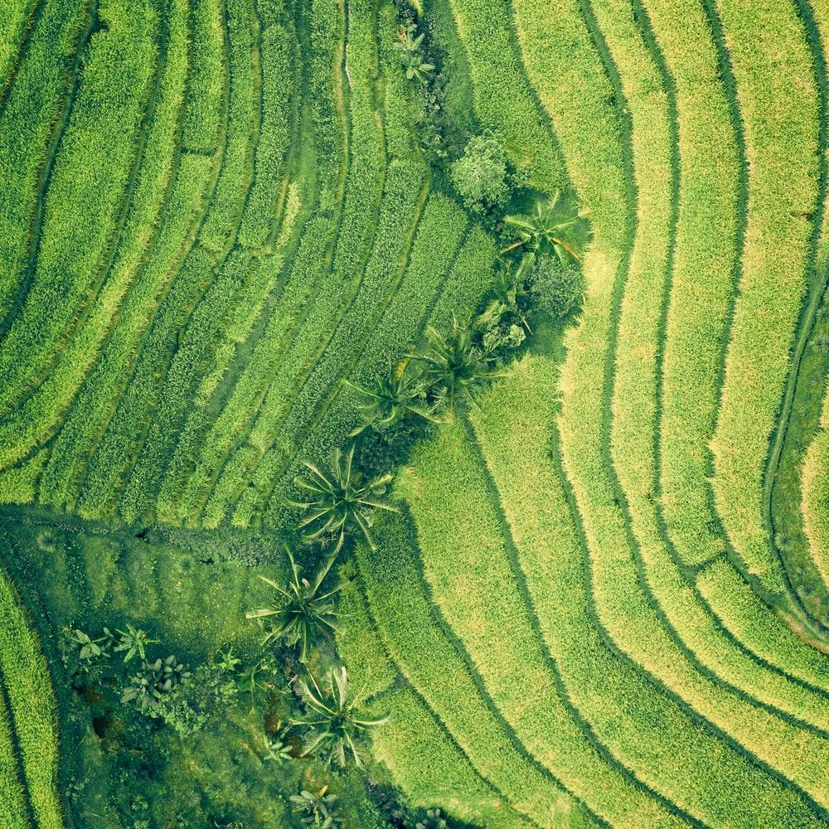
NATURE HELPING HANDS

Slide 3

All of us are want to do something for nature are atleast want to participate in nature events but they are not unable to do because of lack money or they don’t know where the event was going on. Like that peoples my webpage is very useful.
Let’s start with the first set of slides

Slide 4
These are the contents of my webpage 1.Registaration form 2.Login form 3,Acheivements 4.Shoping 5.Nature Events 6.contact us 7.Accident’s 8.Doctor’s Help 9.condact events

Slide 5
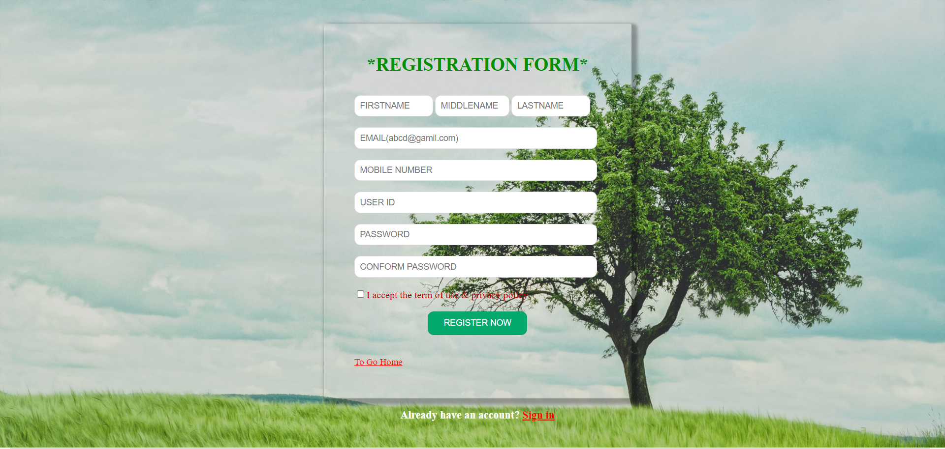
Registration form
This is the registration form
If you register than
You can enter my webpage
I use forms, div concept to create
This page

Slide 6
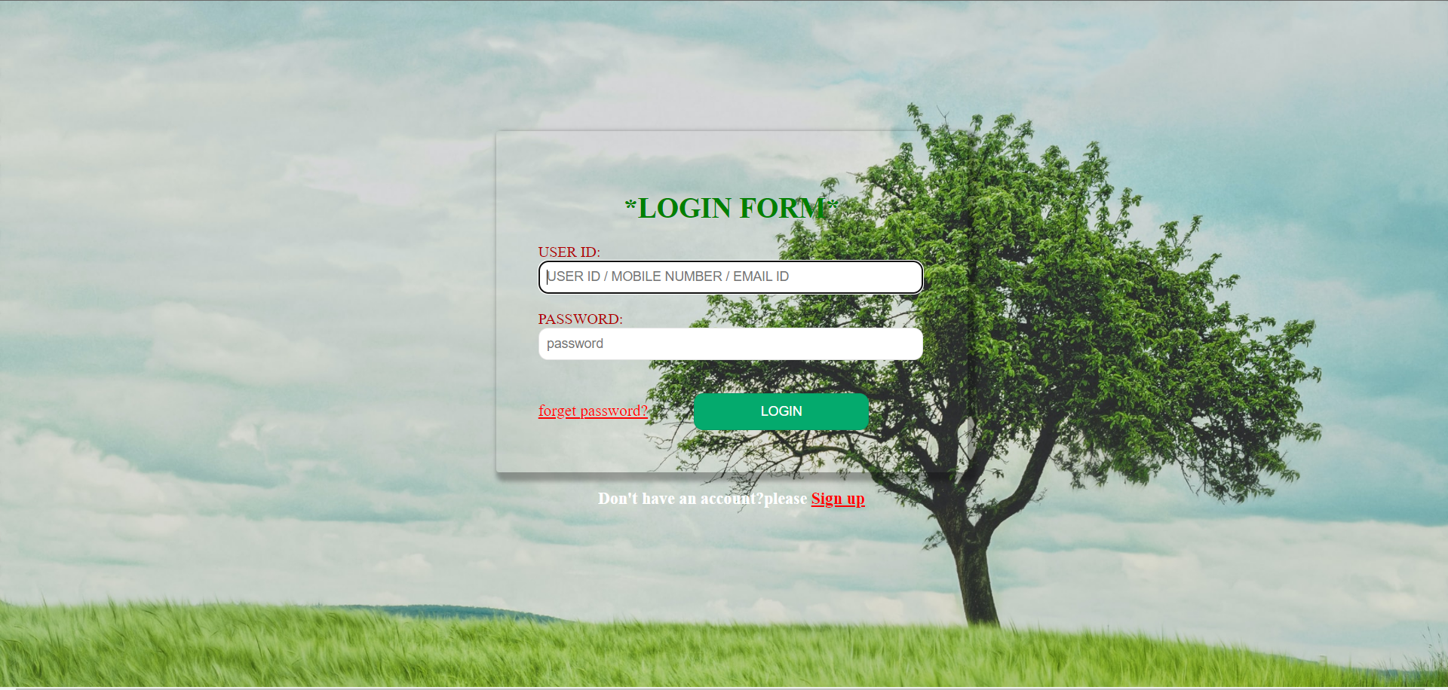
Login form
This is the login form
I use forms, div concept to create
This page

Slide 7
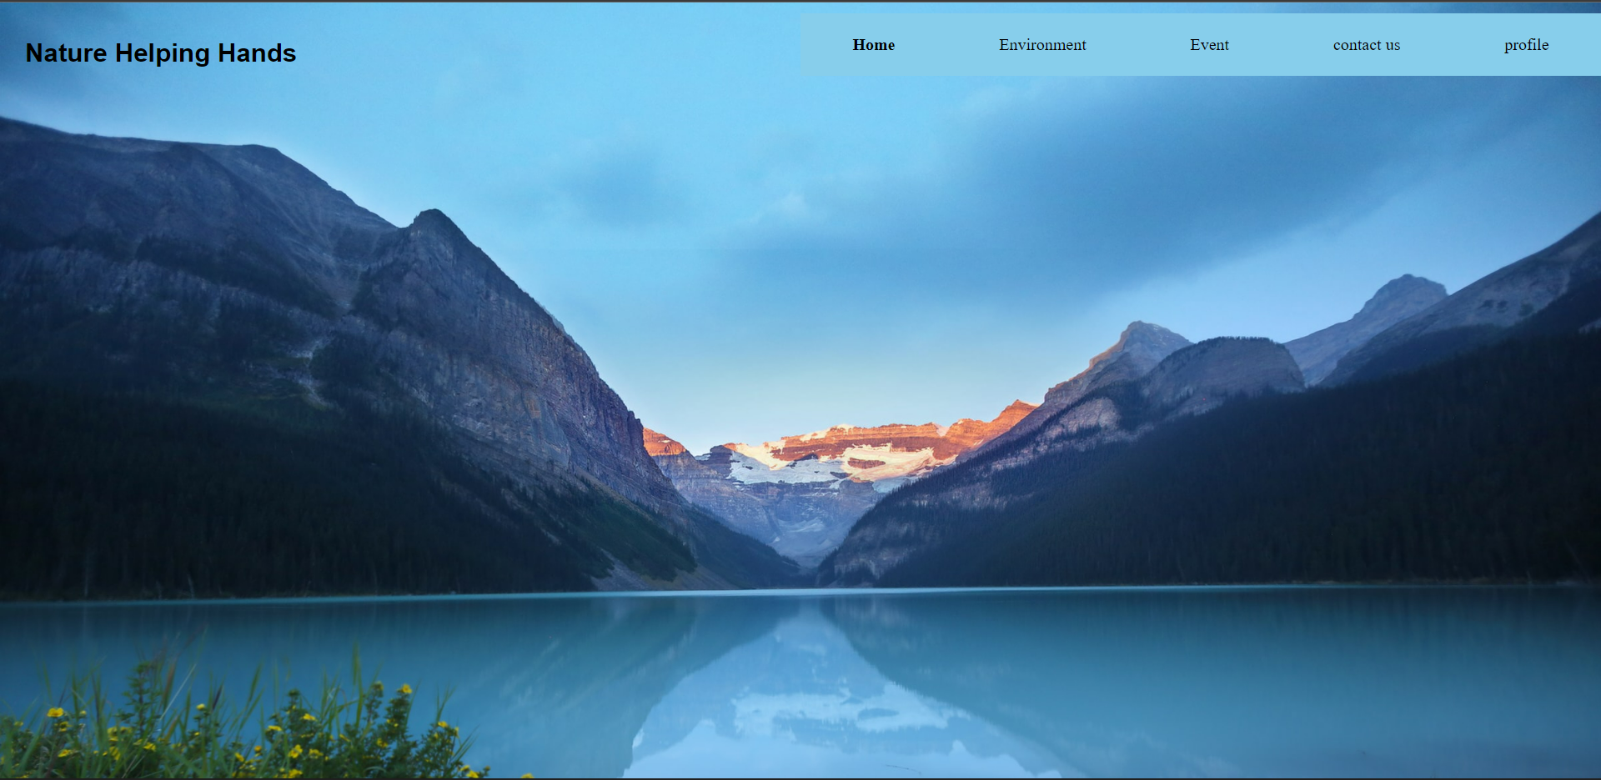
Main page

Slide 8
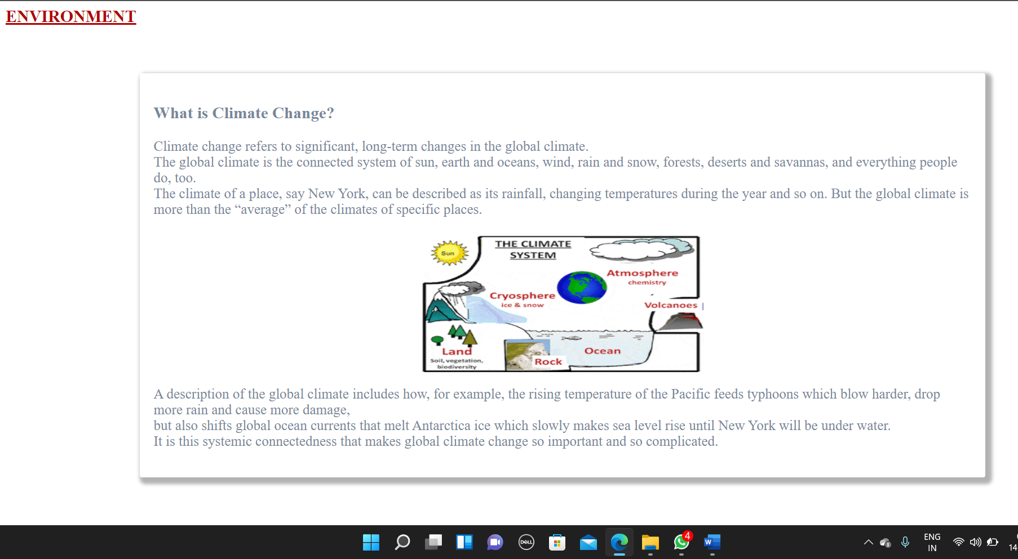
Environment

Slide 9
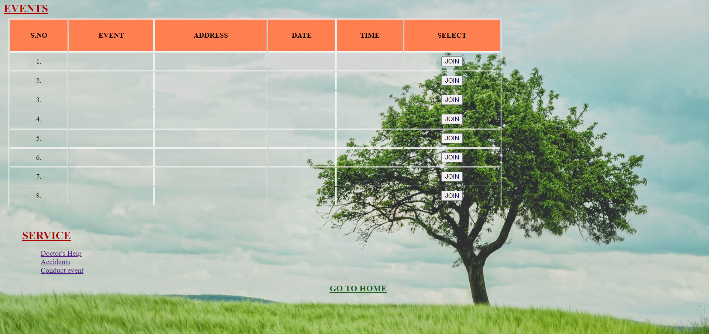
Events
This is the nature events page.
In this page you can select the
Events which is near to your
Locality.
You can able to join that event
By simply click on join button.
For this page I use tables in html

Slide 10
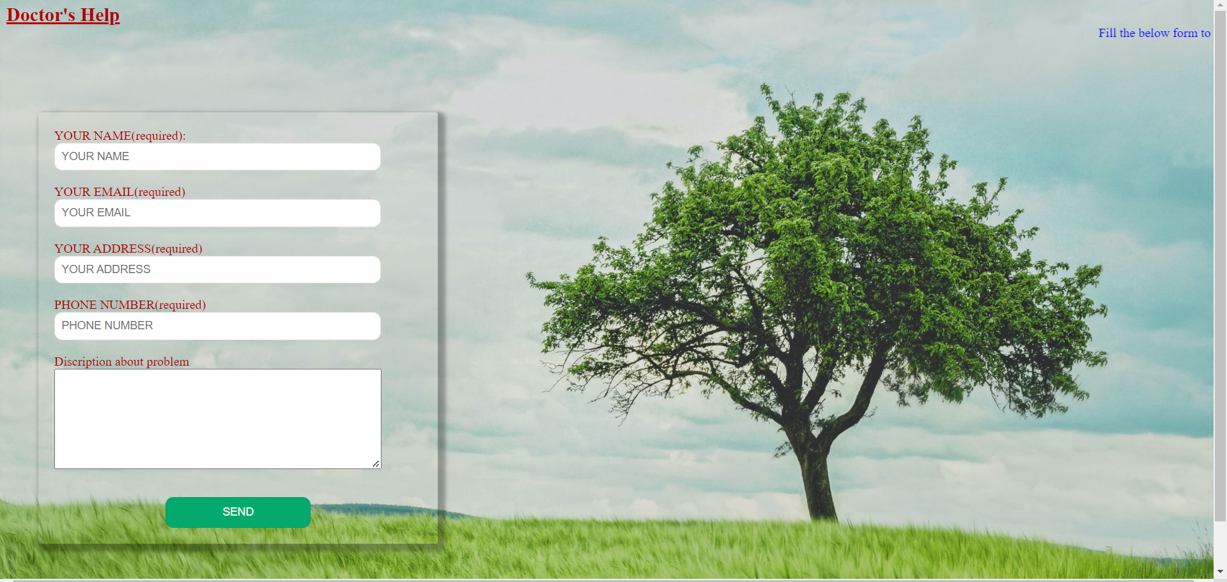
Doctors’help
You have the pet ,dog or any
Animals then you are worried about
Their health then this page is usefull
For you
If you post your problem then my
Doctor’s can send solution to your
problem

Slide 11
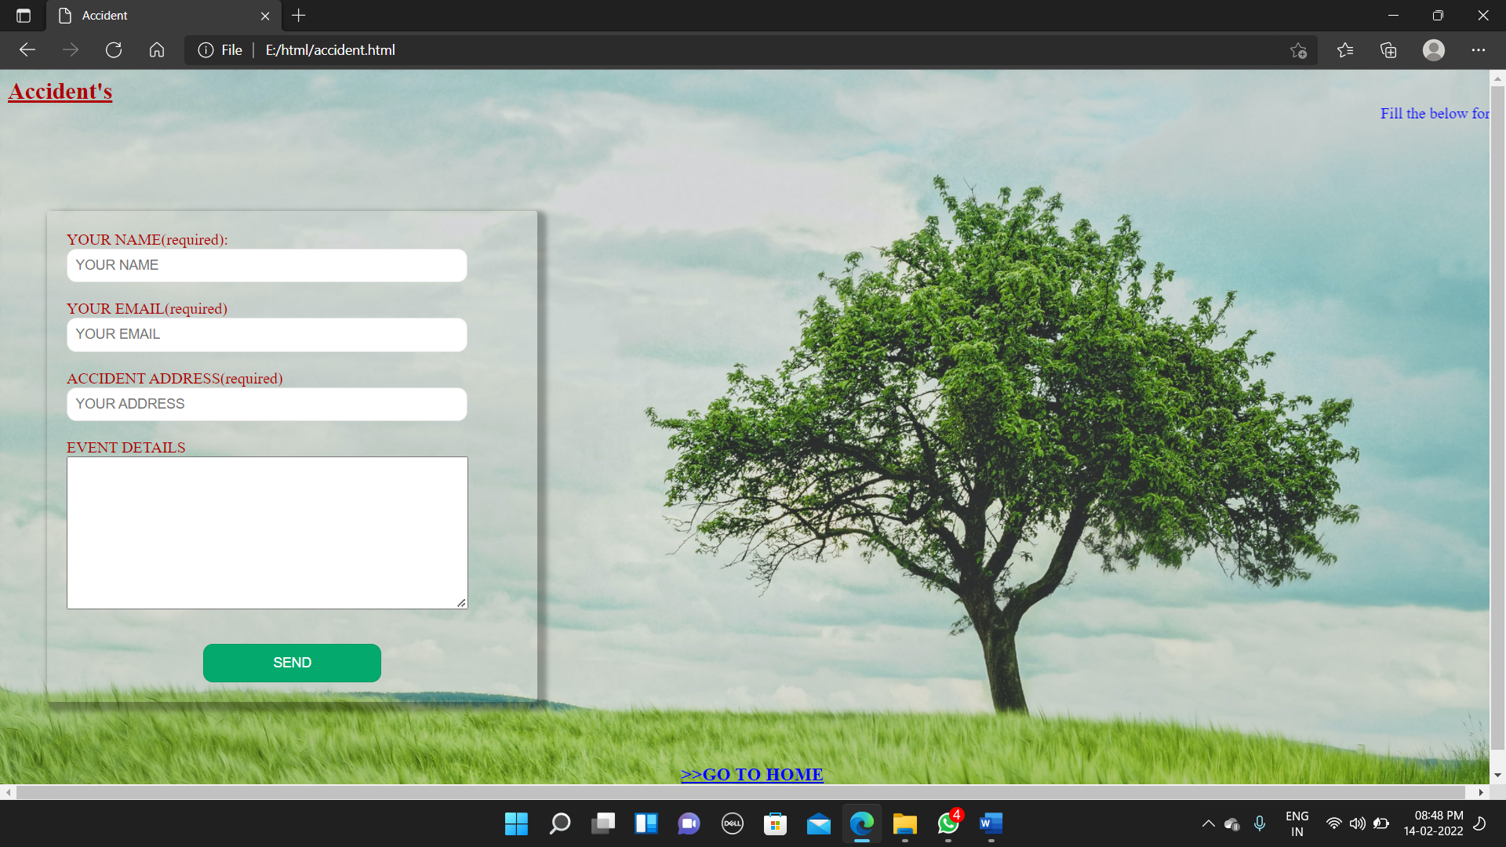
Accident’s
We are in going to home or in journey
We saw the Accidents of animals
on the road we are worried about that
So this page is page very usefull in that case
If you entered the details of the
Accident then my team will take action in 5min

Slide 12

Register to an event
If your trying to plant the loat of plants
In your locality but you can’t do that event by
Single then your can register the event in this
Page. Then we post the event in nature event
Page
Then people who have interest they can join

Slide 13
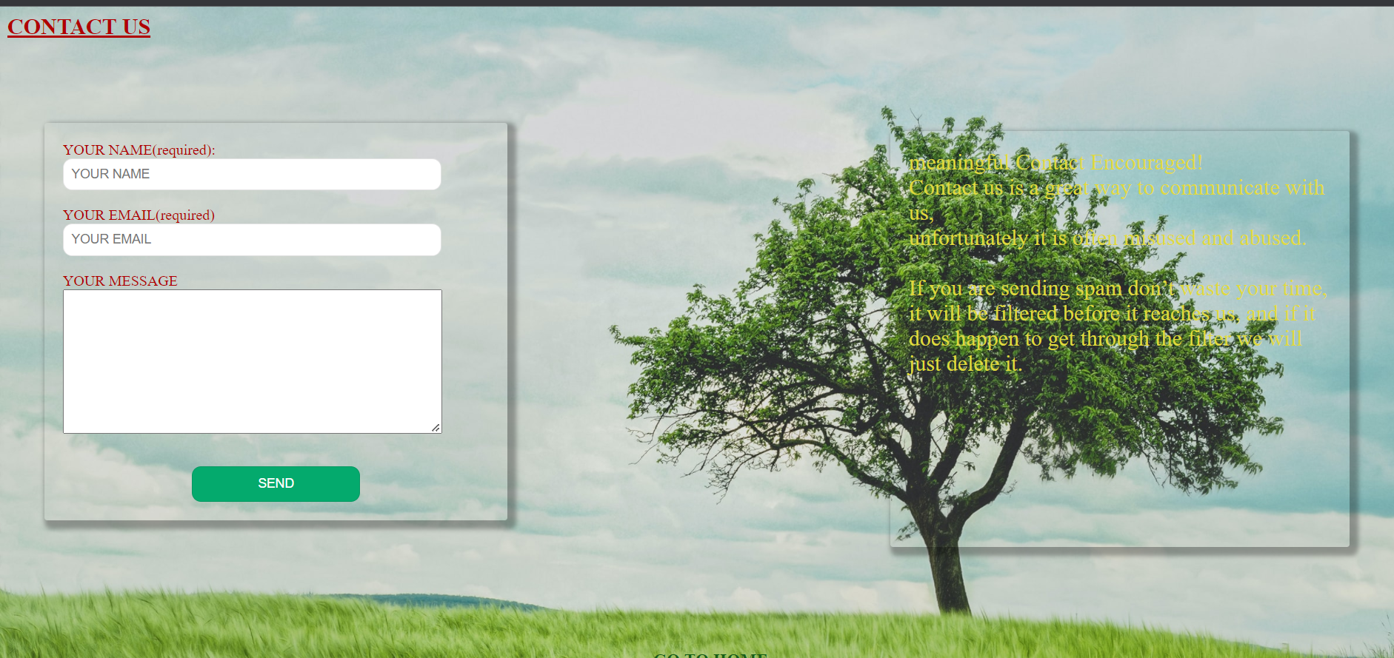
Contact us
If you have any queries
You can contact us
By using this page
I use the forms
Background tags

Slide 14
Thank you

